Slide 1
AI and Ethics-
Regulation
Corenson Terry, Michael Amoo and Terrence Lane II
CYS 323: Cyber Ethics, Law, and Policy in Cyberspace

Slide 2
Regulating Artificial Intelligence: An Overview
AI is becoming deeply embedded in nearly every aspect of modern society, transforming industries, economies, and daily life. From healthcare diagnostics and financial decision-making to autonomous vehicles and smart assistants, AI is reshaping how we work, communicate, and solve problems.
Key question: What should ethical AI regulations look like, and who should enforce them?

Slide 3

Regulating Artificial Intelligence: Ethical Concerns-
Bias and discrimination in AI algorithms.
Privacy and data security risks.
Lack of transparency in decision-making.
Autonomous decision-making and human control.

Slide 4

Regulating AI: The Need for AI Regulation
Preventing unethical use of AI (ex., deep fakes/misinformation, biases).
Ensuring fairness,
and transparency.
Protecting jobs and economic stability.
Aligning AI advancements with human rights.

Slide 5

Case Study #1
Italy’s temporary ban on ChatGPT (2023)
Italy’s data protection authority temporarily banned ChatGPT, citing privacy violations under GDPR. OpenAI lacked transparency in data collection and failed to implement age verification.
The ban was lifted after OpenAI introduced clearer data policies, age restrictions, and user opt-out options to comply with European regulations.
This case highlights the need for global AI privacy regulations to ensure accountability and prevent fragmented enforcement across different countries.

Slide 6
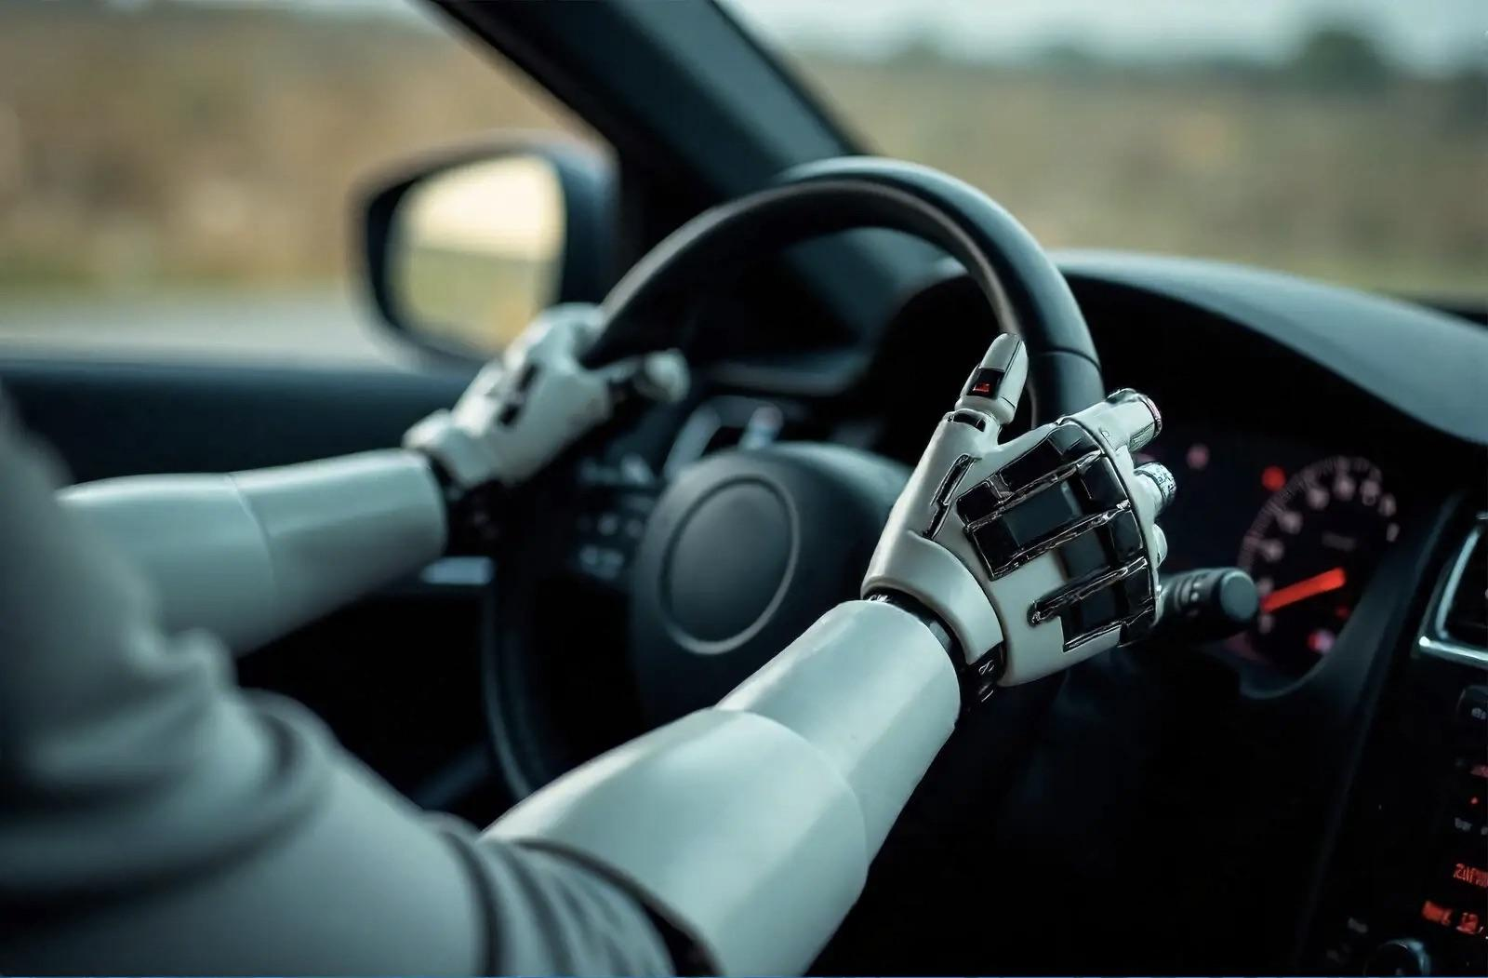
Case Study #2
Tesla’s Autopilot AI Investigation (2023)
Tesla’s Autopilot system was involved in multiple fatal crashes, leading to a U.S. NHTSA investigation over misleading marketing and lack of human oversight.
Regulators mandated software updates and safety recalls, reinforcing the need for sector-specific AI regulations in high-risk industries like autonomous driving.
This case demonstrates the importance of balancing AI innovation with public safety through strict regulatory oversight.

Slide 7
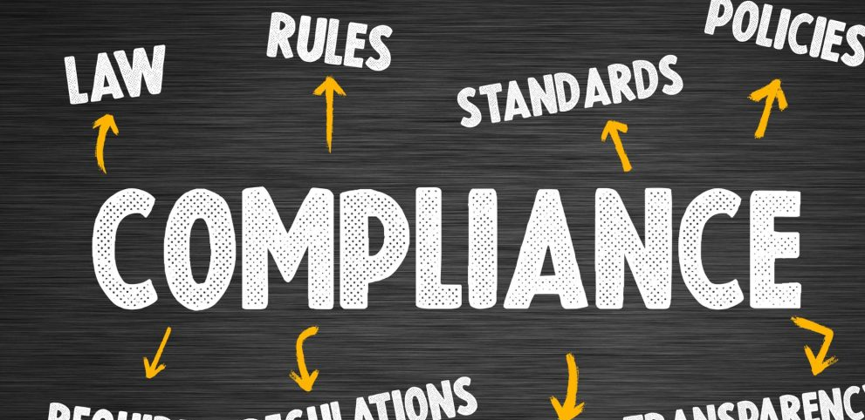


Regulating AI: Governing Concerns
Innovation V.S Regulatory Compliance
Balancing between Innovation & Compliance
Global Regulation Difficulties
Taking into account global regulatory perspectives
Sector-Specific Regulations
Each field is impacted differently by AI, how do we go about this?

Slide 8


Regulating AI: Governing Bodies
Globally:
European Union- Artificial Intelligence Act:
First Act Passed for AI Reg.
Use AI to achieve global goals and Sustainability
OECD: U.S, Canada, Mexico, Japan, +more:
Principles of transparency, responsibility, and inclusion in the development and implementation of AI
Sector-Specific Regulations:
Decentralized
Evolves with Technology
Often led by Government-established Agencies
Ex: Healthcare- Regulations include data privacy laws for patient’s data to remain private.
Notes:
Organization for Economic Co-operation and Development

Slide 9
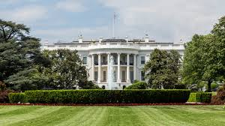

Regulating Artificial Intelligence: Conclusion
Global Regulatory body:
Important for Global Transparency & Broad Oversight
Sectoral Regulations:
Arguably the most Flexible, specific type of regulation.
Global Transparency is important for both innovation & regulation
Sectoral Regulations: Essential to protect jobs, and people.
Allows for stricter, or looser regulations depending on the sector.

Slide 10
References
https://www.captechu.edu/blog/ethical-considerations-of-artificial-intelligence
Walter, Y. Managing the race to the moon: Global policy and governance in Artificial Intelligence regulation—A contemporary overview and an analysis of socioeconomic consequences. Discov Artif Intell 4, 14 (2024). https://doi.org/10.1007/s44163-024-00109-4
https://www.spiceworks.com/tech/artificial-intelligence/articles/ai-regulations-around-the-world/
https://iapp.org/resources/article/us-federal-ai-governance/#policy-white-house
Musch, Sean and Borrelli, Michael and Kerrigan, Charles, The EU AI Act As Global Artificial Intelligence Regulation (August 23, 2023). Available at SSRN: https://ssrn.com/abstract=4549261 or http://dx.doi.org/10.2139/ssrn.4549261
Vinuesa, R., & Holmberg, K. (2023). Ethical implications of large AI models: The ChatGPT controversy. AI & Society, 38(4), 1125-1142. https://doi.org/10.1007/s00146-023-01523-w
Goodall, N. J. (2023). Regulating self-driving cars: Ethics, safety, and the law. Transportation Research Interdisciplinary Perspectives, 18, 100873. https://doi.org/10.1016/j.trip.2023.100873

